Slide 1
1 CORINTHIANS
Here are a number of animated slides you can use in your sermon or lessons. Feel free to edit the slides as meets your needs. You will, of course, want to delete theses words (and perhaps others) before you use them. These slides follow the article above.
Low Chai Hok,
ALBERITH, 2020

Slide 2
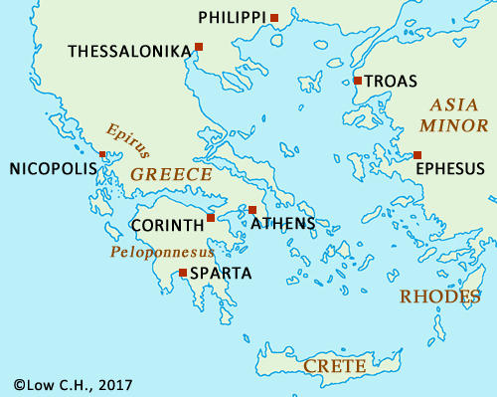

Slide 3
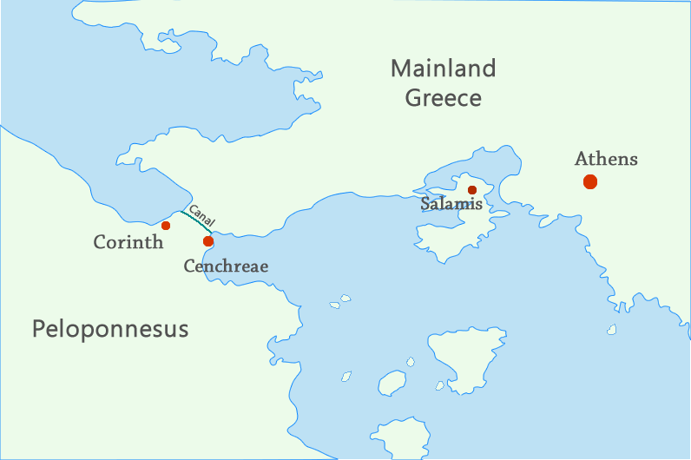

Slide 4
Paul & the Church in Corinth
1. Paul’s First Visit to Corinth, Acts 18:1-18
1. Paul’s First Visit to Corinth, Acts 18:1-18

Slide 5
Paul & the Church in Corinth
1. Paul’s First Visit to Corinth, Acts 18:1-18
2. Apollos Goes to Corinth, Acts 18:27-28
Apollos Goes to Corinth, Acts 18:27-28

Slide 6
Paul & the Church in Corinth
1. Paul’s First Visit to Corinth, Acts 18:1-18
2. Apollos Goes to Corinth, Acts 18:27-28
3. Paul’s Two Possible Other Visits to Corinth, 2 Cor 2:1; 12:14
“a painful visit” – 2 Cor 2:1
“a third visit” – 2 Cor 12:14

Slide 7
Paul & the Church in Corinth
1. Paul’s First Visit to Corinth, Acts 18:1-18
2. Apollos Goes to Corinth, Acts 18:27-28
3. Paul’s Two Possible Other Visits to Corinth, 2 Cor 2:1; 12:14
4. Paul’s “Earlier Letter,” 1 Cor 5:9
“an earlier letter” – 1 Cor 5:9

Slide 8
Paul & the Church in Corinth
1. Paul’s First Visit to Corinth, Acts 18:1-18
2. Apollos Goes to Corinth, Acts 18:27-28
3. Paul’s Two Possible Other Visits to Corinth, 2 Cor 2:1; 12:14
4. Paul’s “Earlier Letter,” 1 Cor 5:9
5. Paul Sends Timothy to Corinth, 1 Cor 4:17
Paul sends Timothy to Corinth – 1 Cor 4:17

Slide 9
Paul & the Church in Corinth
1. Paul’s First Visit to Corinth, Acts 18:1-18
2. Apollos Goes to Corinth, Acts 18:27-28
3. Paul’s Two Possible Other Visits to Corinth, 2 Cor 2:1; 12:14
4. Paul’s “Earlier Letter,” 1 Cor 5:9
5. Paul Sends Timothy to Corinth, 1 Cor 4:17
6. Paul Visited by Stephanas, Fortunatus, and Achaicus, 1 Cor 16:17
Paul visited by Stephanas, Fortunatus, and Achaichus, – 1 Cor 16:17

Slide 10
Paul & the Church in Corinth
1. Paul’s First Visit to Corinth, Acts 18:1-18
2. Apollos Goes to Corinth, Acts 18:27-28
3. Paul’s Two Possible Other Visits to Corinth, 2 Cor 2:1; 12:14
4. Paul’s “Earlier Letter,” 1 Cor 5:9
5. Paul Sends Timothy to Corinth, 1 Cor 4:17
6. Paul Visited by Stephanas, Fortunatus, and Achaicus, 1 Cor 16:17
7. Paul Hears of Divisions from Chloe’s Family, 1 Cor 1:11
Paul hears of divisions in the church from Chloe’s family, – 1 Cor 1:11

Slide 11
Paul & the Church in Corinth
1. Paul’s First Visit to Corinth, Acts 18:1-18
2. Apollos Goes to Corinth, Acts 18:27-28
3. Paul’s Two Possible Other Visits to Corinth, 2 Cor 2:1; 12:14
4. Paul’s “Earlier Letter,” 1 Cor 5:9
5. Paul Sends Timothy to Corinth, 1 Cor 4:17
6. Paul Visited by Stephanas, Fortunatus, and Achaicus, 1 Cor 16:17
7. Paul Hears of Divisions from Chloe’s Family, 1 Cor 1:11
8. Paul Receives Letter from the Church in Corinth, 1 Cor 7-14
Paul receives letter from the church in Corinth, – 1 Cor 7-14

Slide 12
Paul & the Church in Corinth
1. Paul’s First Visit to Corinth, Acts 18:1-18
2. Apollos Goes to Corinth, Acts 18:27-28
3. Paul’s Two Possible Other Visits to Corinth, 2 Cor 2:1; 12:14
4. Paul’s “Earlier Letter,” 1 Cor 5:9
5. Paul Sends Timothy to Corinth, 1 Cor 4:17
6. Paul Visited by Stephanas, Fortunatus, and Achaicus, 1 Cor 16:17
7. Paul Hears of Divisions from Chloe’s Family, 1 Cor 1:11
8. Paul Receives Letter from the Church in Corinth, 1 Cor 7-14
9. Paul Writes 1 Corinthians, 1 Cor (?)
Paul writes 1 Cor (?)

Slide 13
Paul & the Church in Corinth
1. Paul’s First Visit to Corinth, Acts 18:1-18
2. Apollos Goes to Corinth, Acts 18:27-28
3. Paul’s Two Possible Other Visits to Corinth, 2 Cor 2:1; 12:14
4. Paul’s “Earlier Letter,” 1 Cor 5:9
5. Paul Sends Timothy to Corinth, 1 Cor 4:17
6. Paul Visited by Stephanas, Fortunatus, and Achaicus, 1 Cor 16:17
7. Paul Hears of Divisions from Chloe’s Family, 1 Cor 1:11
8. Paul Receives Letter from the Church in Corinth, 1 Cor 7-14
9. Paul Writes 1 Corinthians, 1 Cor (?)
10. Paul Writes “a Sorrowful Letter,” 2 Cor 7:8
Paul writes “a sorrowful letter,” 2 Cor 7:8

Slide 14
Paul & the Church in Corinth
1. Paul’s First Visit to Corinth, Acts 18:1-18
2. Apollos Goes to Corinth, Acts 18:27-28
3. Paul’s Two Possible Other Visits to Corinth, 2 Cor 2:1; 12:14
4. Paul’s “Earlier Letter,” 1 Cor 5:9
5. Paul Sends Timothy to Corinth, 1 Cor 4:17
6. Paul Visited by Stephanas, Fortunatus, and Achaicus, 1 Cor 16:17
7. Paul Hears of Divisions from Chloe’s Family, 1 Cor 1:11
8. Paul Receives Letter from the Church in Corinth, 1 Cor 7-14
9. Paul Writes 1 Corinthians (?)
10. Paul Writes “a Sorrowful Letter,” 2 Cor 7:8
11. Paul Writes 2 Corinthians (?)
Paul writes 2 Corinthians (?)

